Slide 1
React application for making invoices.
INVOICER
APP

Slide 2
Making
CREATIVE
solutions

Slide 3

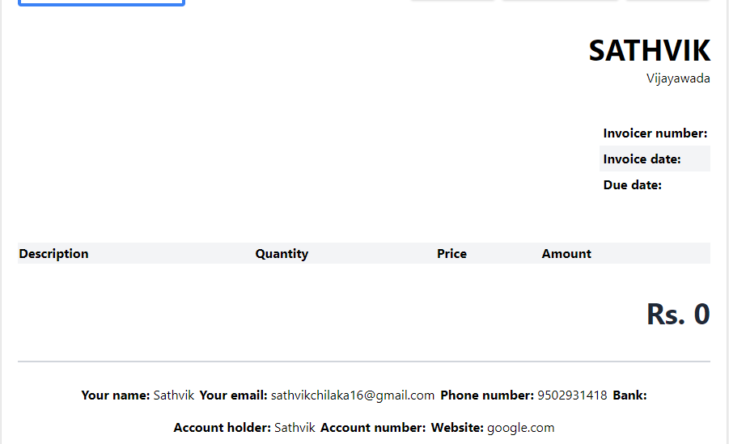
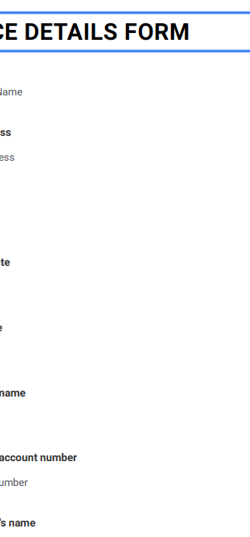
Our Invoicer App can be used seamlessly with both mobile or laptop or bigger screens.

Slide 4
INVOICER
APP
Team Honey

Slide 5


TEAM HONEY
Sujith & Sathvik
Pre-Final Year Computer Science Students at IIT Bhubaneswar

Slide 6
Flexible Components
All the components that we make sure
that they can be edited seamlessly later on.
01
02
Entire Info Collection
Collects extensive and entire info about the client for creating the invoice.
Smart Previewing
Total amount breakdown of the purchases will be available for the invoicer along with few extra edits.
03
04
Being Unique
Every invoice is unique as we assign invoice ids for each of them

Slide 7
Invoice Details Form
Firstly we take the entire info about the purchases and we give freedom to the invoicer in flexibility of info filling.
S
Step-1
Editing Client’s
Purchases
Step-2
W
Invoicer can add or delete or edit multiple items of the invoice purchases with respect to the requirement
Amount Preview
In Rupees.
R
STEP-3
Invoice Receipt
After submitting the info of the purchases, it will be finally ready for print/download/share upon further more edits can take place for one’s own requirements.
Step-4
b
Billing it!
When everything seems good, invoicer can simply bill it by his own methods.
j
Step-5

Slide 8
INVOICER
APP
Thank You

